Slide 1
An Introduction to Programming in VHDL
Marios S. Pattichis

Slide 2
Contents
Introduction
How to Define a Comment
Basic Definitions
The entity command
Input/Output Signals
Function calls using port map
Defining Architectures
Defining Functions
An Example of a Multiplier in Behavioral Style

Slide 3
Introductory Comments on Hardware Description Languages
VHDL means VHSIC Hardware Description Language, where VHSIC
stands for Very High Speed Integrated Circuit.
The main characteristics of VHDL include:
allows for Hierarchical Design
every element of the language must define an interface that can be used to simulate behavior of hardware

Slide 4
Comments
Comments begin with the two characters -- and continue until the end
of the line.
Examples:
-- This comment starts at the beginning of a line.
A <= B+C; -- This comment starts at the end of a command line.
We need to give comments to describe:
all the input/output variables
for all definitions
for describing non-intuitive operations
in general, the more comments, the better

Slide 5
Basic Rules for User Definitions
For user definitions, the following restrictions apply:
all identifiers must start with a letter (eg. a, b, c, …)
this is followed by a combination of letter(s), number(s), and underscore(s) _ (cannot have two underscores together: __ )
there is no disticntion between lower case and upper case
The following represent valid names:
BusWidth, A1, A2, The_Input_Signal.
The following do not represent valid names:
1bit, _aNumber, $aName, two__underscores.
There is no difference among the following:
BusWidth, buswidth, busWidth.

Slide 6
Example Definitions Using type
type typeName is (enumeratedList)
enumeratedList is given as a list of words or characters (type
characters), separated by commas.
Examples using definitions from ΙΕΕΕ:
type std_ulogic is ('U', 'X', '0', '1', 'Z', 'W', 'L', 'H', '-');
Examples using words:
type SpecialType is (valueA, valueB, valueC, valueD);
Note: Ordering matters. For example:
valueA to valueC implies valueA, valueB, valueC
valueA downto valueC does not include any value

Slide 7
Example Definitions using subtype and constant
subtype subtypeName is knownType range Value1 to Value2
subtype subtypeName is knownType range Value1 downto Value2
Examples:
subtype unsignedTwoBit is integer range 0 to 3
subtype bitNumber is integer range 1 downto 0
constant constantName : knownType := newValue;
Examples:
constant BusSize : integer := 32;
constant UnknownVal : character := 'U';

Slide 8
Constants, Variables, and Signals (I/II)
p.68, VHDL Design Representation and Synthesis, 2nd Ed, Armstrong and Gray.
Constant: An object whose value is specified at compile time and
cannot be changed by VHDL statements. Like C.
Variable: A data object whose current value can be changed by VHDL
statements. Like C.
  Only defined within processes or subprograms (subprograms are functions and/or procedures)
  Within a process, the variable is LOCAL and STATIC to the process
    Local means that it is not visible outside the process (like C).
    Static means that the value is kept until the next process call (like C)
    Initialized once at the beginning of the simulation (like C)
    A variable can be declared as shared to be shared between processes (p. 31, The Designer’s Guide to VHDL, 2nd ed.). DO NOT SHARE (not in VHDL-87).
  Within a subprogram, the variable is DYNAMIC
    Dynamic means that the values are not kept until the next call (like C)
    Initialized every time the subprogram is called
  Variables are assigned immediately after the variable statement! We use := to assign them (NOT <= ).

Slide 9
Constants, Variables, and Signals (II/II)
p.68, p.117, VHDL Design Representation and Synthesis, 2nd Ed, Armstrong and Gray.
Signal: A data object that represents an actual physical data line
(wire, gate or circuit input/output) <- UNLIKE C variables!
  It cannot change instantaneously
  It changes at a later time (after assignment)
  It is associated with the TIME DIMENSION
  If no time delay is given, it changes after DELTA TIME
  Default behavior is using the INERTIAL DELAY MODEL
  Signals are initialized using :=, but they are assigned using <= (NOT :=).

Slide 10
Transport Delay Model
Transport Delay Model for Signals
Assume that the output will change after the propagation delay
Applies to wires, but it is unrealistic for gates
Example:
sum <= transport (A and B) after 2 ns;
-- sum gets the result after 2 ns.
-- sum must have been initialized as a signal
General form:
sum <= transport value-expression after time-expression;
Note that this is not the default assignment in VHDL!
The default model is the inertial delay model!

Slide 11
Inertial Delay Model
Inertial Delay Model for Signals (default mode)
Signal changes that stay at a value for less than rejection time are filtered out (ignored)
Signal changes affect the output after the propagation delay
More realistic: can be applied to gates
Example: -- NOT PART of VHDL-87, so may not be synthesized!
sum <= reject 1 ns inertial (A and B) after 2 ns;
-- complex assignment (see next slide to see what happens)!
-- assumes that:
-- rejection time = 1ns
-- propagation delay time = 2ns
-- inertial delay model is applied to decide output
General form:
sum <= reject time-expression inertial value-expression after time-expr;

Slide 12
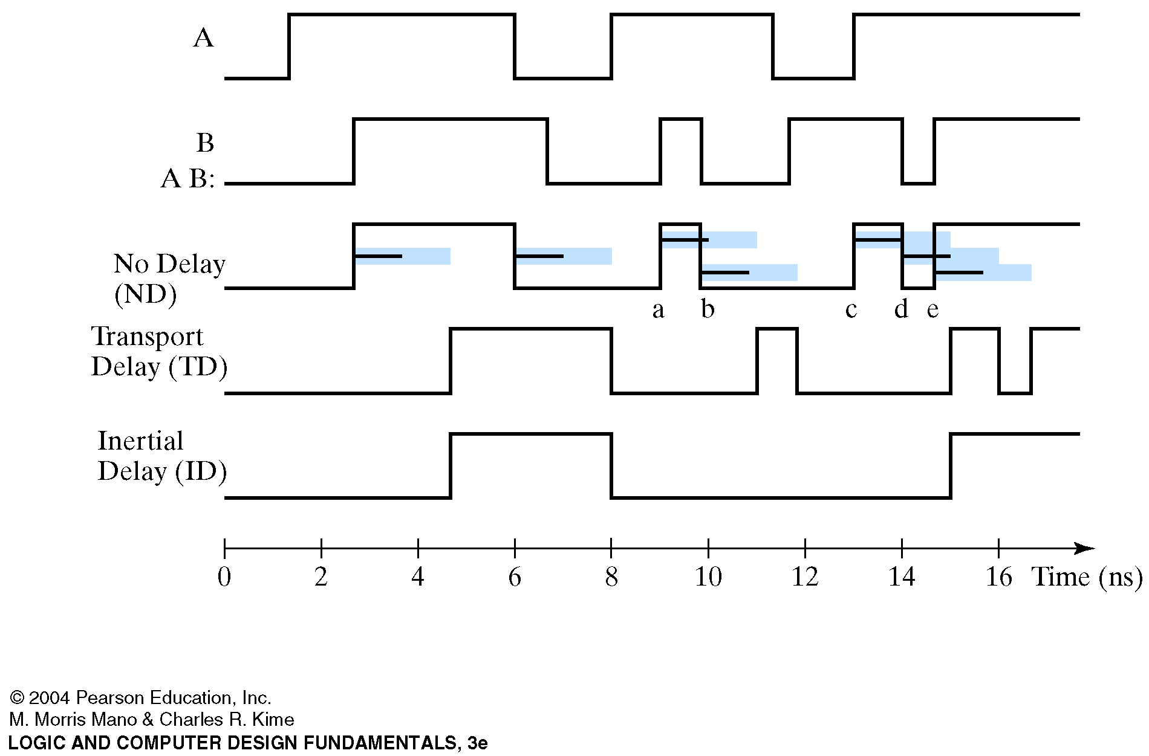
Inertial Delay Example for AND Gate (Mano & Kime)
Rejection time: 1 ns
Propagation delay: 2 ns

Slide 13
Two More Examples of Signal Assignment
Example 2:
sum <= A and B after 2 ns;
-- assumes that:
-- rejection time = 2 ns
-- propagation delay time = 2 ns
-- inertial delay model is applied to decide output
Example 3:
sum <= A and B;
-- assumes that:
-- rejection time = Delta Time (internal constant)
-- propagation delay time = Delta Time
-- inertial delay model is applied to decide output
This is the most common and default mode of operation!

Slide 14
Initializing Signals
Example:
signal s1, s2 : std_ulogic := ‘U’;
-- We define two signals: s1 and s2 of type std_ulogic
-- recall the definition of std_ulogic!
-- The signals are initialized to ‘U’:
-- Only once if the signal is defined in a process
-- Every time a sub-program is called if the signal is defined in a
-- subprogram.
General Form:
signal signal-list : signal-type := valid-initial-expression;

Slide 15
Options for Signals (modeType)
Every signal can be defined using any one of the following:
in This is an input signal. We can expect that the input variable has a pre-defined value that we can use.
out This is an output signal. We can give a value to this
signal. We cannot read the value given to this signal
inside the entity definition.
inout We can use this signal as an input or an output
signal. It allows all the operations given by in or out.
buffer This definition is equivalent to a signal of type out, but
it also allows us to read its value internally (not before it is assigned though, else it is the same as inout)

Slide 16
Definitions using entity
An entity provides a prototype that:
defines all the input and output signals using mode-types
several different implementations can use this entity interface!
the different implementations are given using architecture commands
The general definition of an entity is given as:
entity entityName is
[generic (generic_interface_list)] -- optional list of constant
-- design parameters
port (signalList1 : modeType signalType;
signalList2 : modeType signalType;
…
signalListN : modeType signalType); -- no need for ";"
end entityName;
Here, entityName is user defined.

Slide 17
Definitions using component declarations
p. 318, The Designer’s guide to VHDL, 2nd ed.
A component provides an idealized prototype that:
it will be part of an architecture defining an entity
lower level primitive often provided by IEEE libraries (eg: gates)
The general definition of a component is given as:
component identifier [is]
[generic (generic_interface_list);]
[port (port_interface_list);]
end component [identifier];
Notes:
text enclosed in square brackets ([..]) is optional
generic is a list of constant design parameters (not variables)
port defines the input/output signals

Slide 18
How to Make a Call Using port map
We can call a function (defining a component), after it has been
defined, using:
UniqueLabel1: componentName1 port map (firstSignal1, …, firstSignalN);
:
UniqueLabelN: componentNameN port map (lastSignal1, …,
lastSignalN);
In VHDL, there is a classical way of calling a function (as in “C”), that is
based in the order of the variables. The second, preferred way, is to
give the association between the input and output variables.

Slide 19
Using port map
We can define a memory component using:
component JK_FF -- J, K flip-flop
port (CLK : in std_logic;
J, K : in std_logic;
Reset : in std_logic;
Q, Qneg : out std_logic);
end component;
Then, we can create the component using the following call as in “C”: JK_FF port map (Clkin, Jin, Kin, Resetin, Qout, Qinvout);
However, in VHDL, to avoid errors, we prefer to use:
JK_FF port map (Clkin => Clk, Jin => J, Kin => K,
Resetin => Reset, Qout => Q, Qinvout => Qneg);
In the second example, we can change the order of
how we list the input variables.

Slide 20
Definition Example using component and generic
p. 318, The Designer’s guide to VHDL, 2nd ed.
-- Define the interface of the component:
component flipflop is
generic (Tprop, Tsetup, Thold: delay_length);
port (clk : in bit; clr : in bit; d : in bit;
q : out bit);
end component flipflop;
-- We can then realize the component using:
Bit0: component flipflop
generate map ( Tprop => 2ns, Tsetup => 2ns, Thold => 1ns)
port map (clk => clk, clr => clr, d = d(0), q => q(0));
Note: d(0) and q(0) are local signals.

Slide 21
A General Framework for Defining Procedures
p. 196, The Designer’s guide to VHDL, 2nd ed.
subprogram_body <=
procedure identifier [ (parameter_interface_list) ] is
{subprogram_declarative_part}
begin
{sequential_statement}
end [ procedure ] [ identifier ];
Notes:
Note that procedures are subprograms
Execution in procedures is sequential
Variables in procedures are dynamic. They behave as in C.
They generalize statements

Slide 22
A General Framework for Defining Functions
Function functionName(
signal List1: signal Type;
:
signal ListN: signal Type)
Return returnType is
Various Declerations -- definitions if needed
begin
sequential Statement1 -- sequential execution as in C
:
sequential StatementN
end function Name;
-- Inside the functions, all instructions are executed sequentially, like "C".
-- Functions generalize expressions. They are considered subprograms

Slide 23
A Framework of an Architecture Definition
architecture architectureName of entityName is Various Declarations
-- different definitions given here …
begin
Concurrent Statement 1 -- Everything gets executed in
:
Concurrent StatementN -- parallel until there is no change
end architectureName
Function arguments:
OK to call with the same type or subtype

Slide 24
A Simple Example: A Multiplier Using Behavioral Style (Wakerly, page 453)
library IEEE; -- libaries for the definitions of UNSIGNED and *.
use ΙΕΕΕ.std_logic_1164.all;
use IEEE.std_logic_arith.all;
entity unsignedMul8x8 is
port ( X: in UNSIGNED(7 downto 0); -- eight bits input
Y: in UNSIGNED(7 downto 0); -- eight bits input
P: out UNSIGNED(15 downto 0)); -- sixteen bits output
end unsignedMul8x8
architecture unsignedMul8x8_arch of unsignedMul8x8 is
begin
P <= X*Y;
end unsignedMul8x8_arch;

